Slide 1
IBM University Engagement Project Submission
“Exploring the Power of Machine Learning with IBM Cloud”

Slide 2

Project Tile – [NetworkSentinelAI – Hybrid Intrusion Detection & Agentic SOC Analyst]
Domain of Project – [ Cybersecurity/Network Operations ]
Student Name | Recent Passport Photo | Email ID | Mobile number [WhatsApp]
Sujal Dixit |  | sujaldixitsd@gmail.com | +91 8595339207
Recommended font style and size: Font Style: Arial Font Size (Heading): 28
Font Size (Content): 20

Slide 3
Problem Statement: Network Intrusion Detection
The Industry Challenge
Passive Detection: Traditional Network Intrusion Detection Systems (NIDS) rely on rigid rules and only provide binary "block/allow" alerts.
Alert Fatigue: Security Operations Center (SOC) analysts are overwhelmed by thousands of raw, uncontextualized daily alerts.
The Operational Bottleneck
Slow Triage: Manually investigating complex cyber-attacks (like DoS, Probes, or U2R) is too slow for modern, high-speed network breaches.
Lack of Actionability: Existing tools identify that an anomaly occurred, but fail to tell the analyst how to fix it.
The Project Objective (NetworkSentinelAI)
Hybrid AI Architecture: Build a dual-layer system that leverages predictive Machine Learning (IBM AutoAI) for real-time, mathematical threat classification.
Autonomous Remediation: Integrate Agentic AI (IBM Granite) to act as a digital Tier-1 Analyst—instantly transforming raw network telemetry into structured, human-readable mitigation playbooks.

Slide 4
Proposed Solution
(IBM watsonx.ai Studio – AutoAI):
The solution is a dual-layer architecture integrating predictive Machine Learning with Generative Agentic AI.
Layer 1 (Detection): IBM Watson Machine Learning (AutoAI) processes 41 network telemetry features in real-time against the KDDCup99 dataset to classify packets as Normal, DoS, Probe, etc.
Layer 2 (Response): An Agentic AI powered by IBM watsonx.ai (Granite models) receives the anomaly classification and autonomously acts as a Tier-1 SOC Analyst.
Layer 3 (Interface): A Gradio-based dashboard provides live packet interception, manual telemetry overrides, and instant visualization of both the mathematical threat boundary and the Agent's mitigation playbook.

Slide 5
Technology Used
IBM Watsonx.ai Studio & AutoAI: For autonomous model training and feature engineering.
IBM Watson Machine Learning (WML): For deploying the ML classification endpoint.
IBM watsonx.ai & Granite Models: For natural language reasoning, threat summarization, and generating mitigation playbooks.
IBM Cloud (IAM): For secure API token generation and identity management.
Gradio: For designing and orchestrating the interactive Security Operations Center (SOC) dashboard.

Slide 6
Components Used
Interactive Gradio SOC Dashboard: Serves as the primary user interface, allowing live interception of simulated network telemetry (e.g., protocol types, byte counts, error rates) and manual parameter overrides for edge-case testing.
IBM Watson Machine Learning (AutoAI) Engine: A deployed REST API endpoint that ingests 41 distinct network features and utilizes ensemble machine learning techniques to mathematically classify traffic as Normal or Anomalous.
IBM Watsonx.ai Granite Foundation Models: The cognitive core of the system. Utilizing large language models (like granite-13b-instruct-v2) injected with a strict cybersecurity persona to interpret ML outputs and generate deterministic incident reports.
Python Orchestration Backend: A robust middleware layer that handles secure IBM IAM OAuth token generation, JSON payload mapping, API rate-limit throttling, and automated LLM failover cascades to ensure continuous uptime.

Slide 7
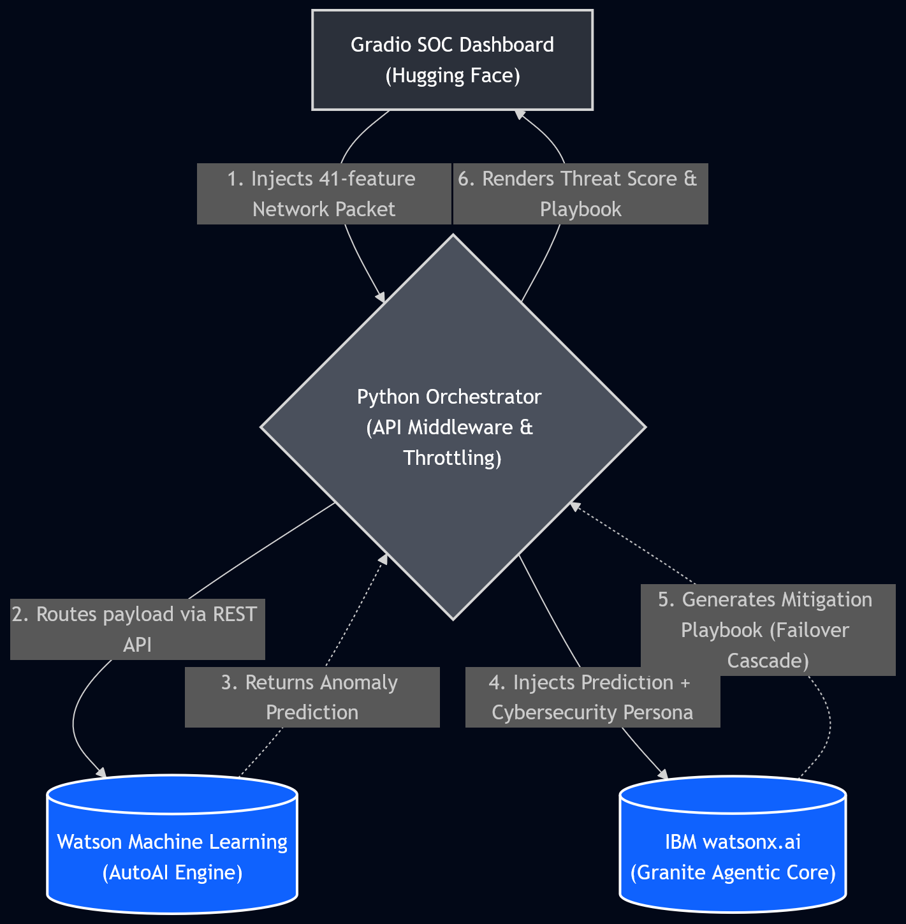
Architecture Blueprint

Slide 8
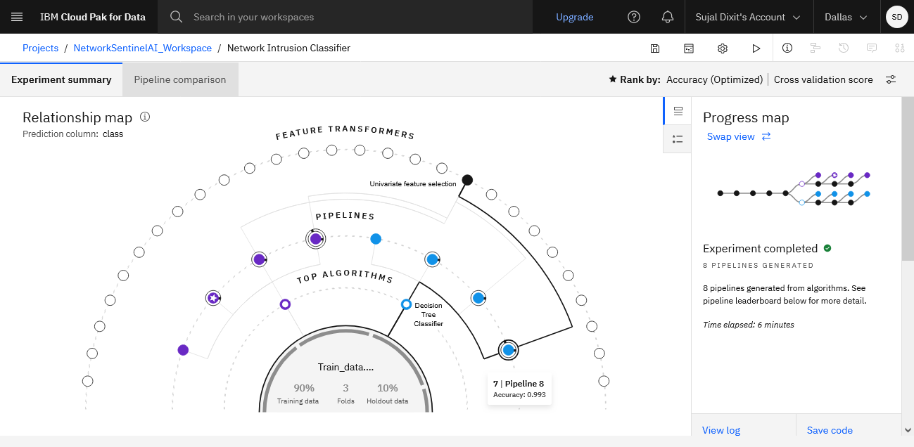
Training Screenshots-

Slide 9
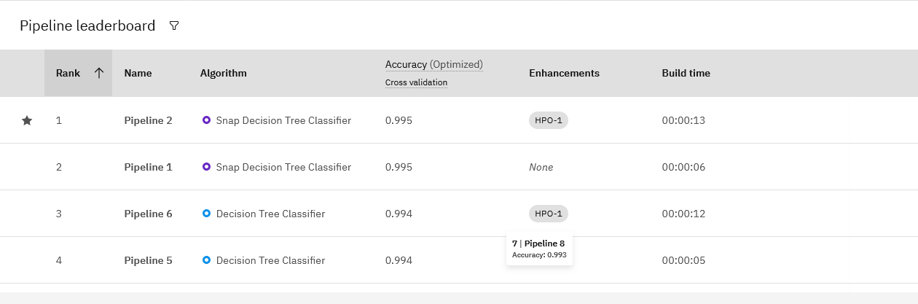
Best Model Screenshot:

Slide 10
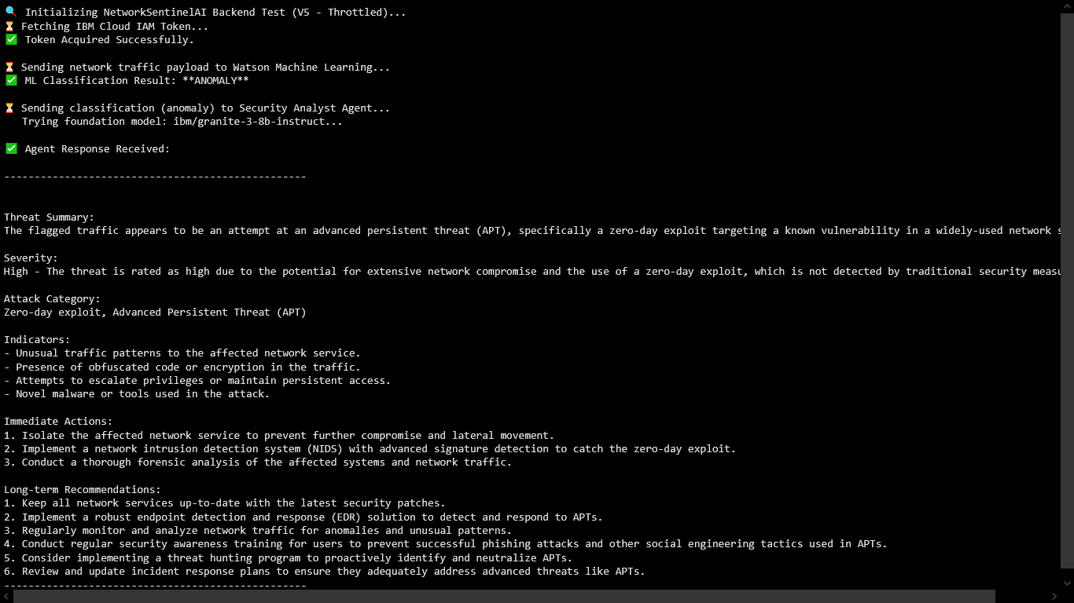
Testing Screenshot:

Slide 11
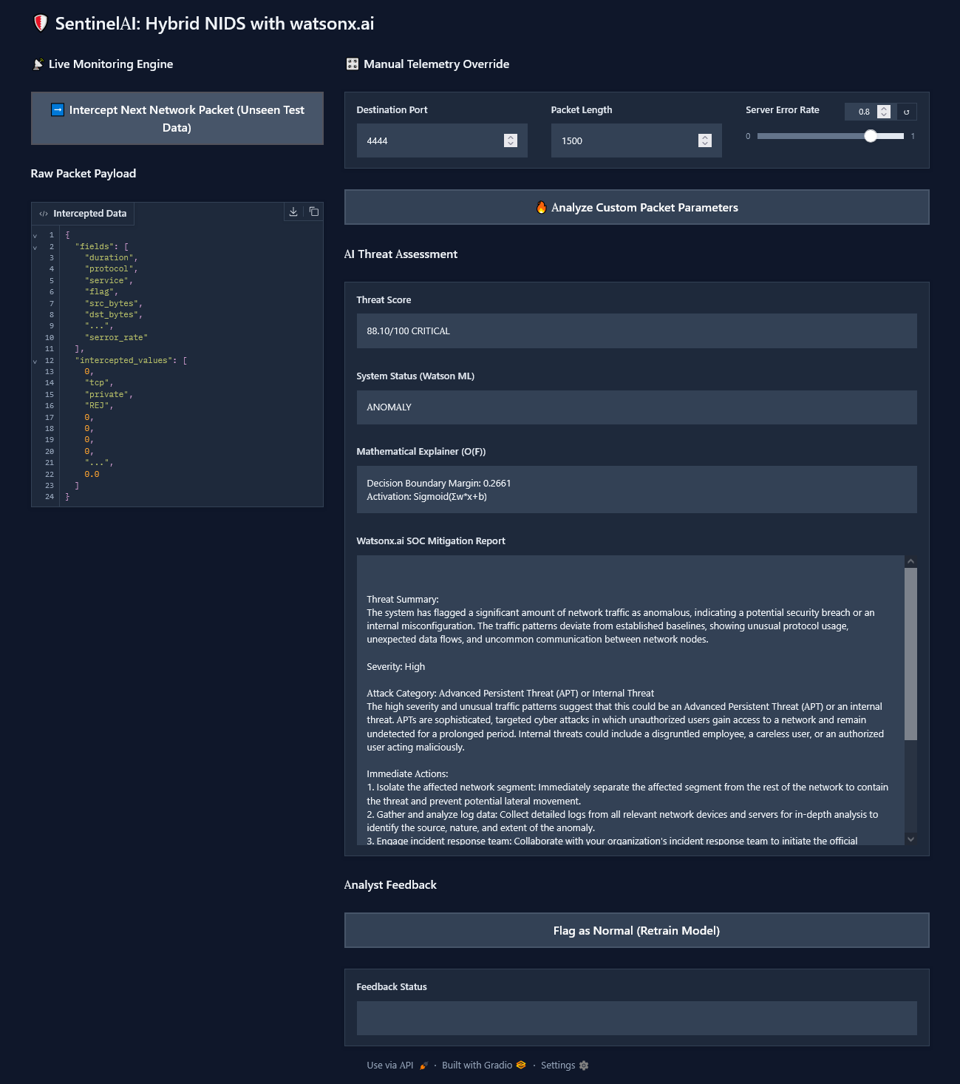
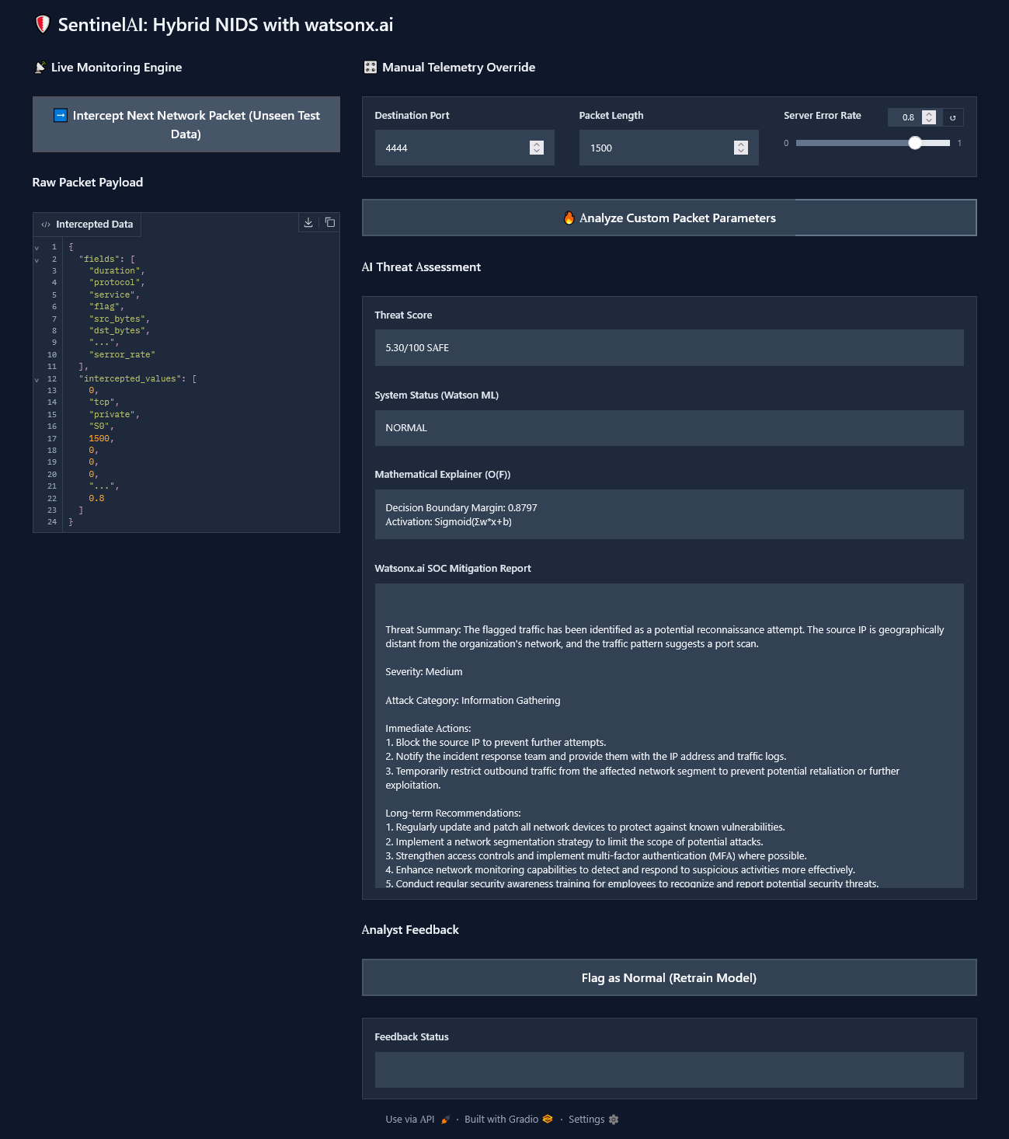
Deployed Interface Screenshot:

Slide 12
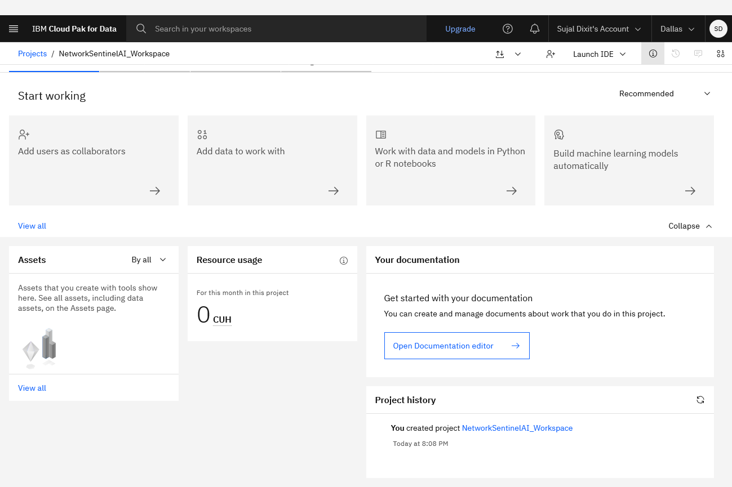
Resource Usage (Before)

Slide 13
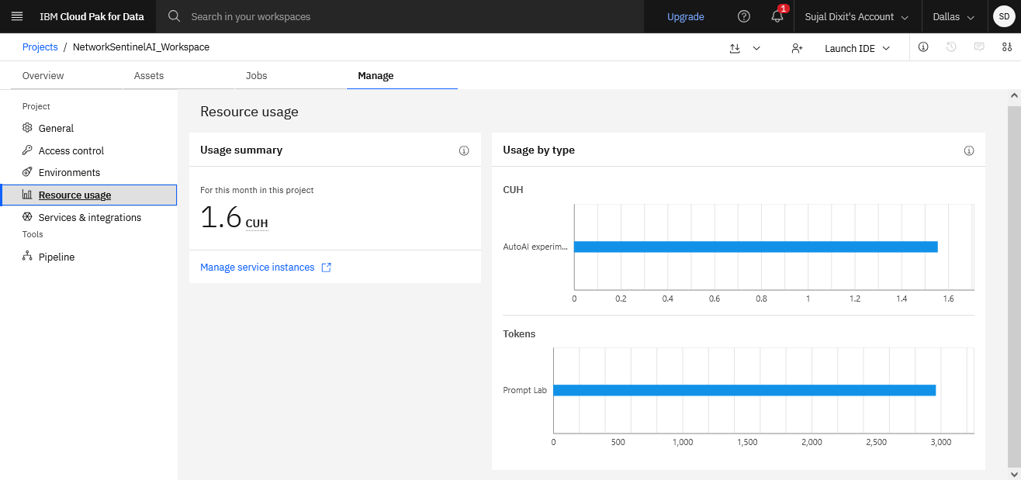
Resource Usage (After)

Slide 14
Novelty and Uniqueness
Hybrid Intelligence Architecture: Unlike traditional NIDS that only provide binary alerts, SentinelAI fuses deterministic predictive ML (for high-accuracy anomaly detection) with probabilistic Generative AI (for contextual, human-readable mitigation), creating a complete end-to-end security pipeline.
Enterprise-Grade API Throttling & Failover: Custom-engineered to maximize IBM Cloud Lite resources, the system features a self-healing backend. If a specific Granite model is rate-limited, the pipeline autonomously reroutes the payload to a fallback model without disrupting the analyst's workflow.
Action-Oriented Contextualization: The system reduces "alert fatigue" by translating complex mathematical boundaries and raw packet telemetry into immediate, step-by-step mitigation playbooks tailored to the specific threat detected.
Zero-Footprint Cloud Deployment: Completely bypasses the need for heavy local compute. The architecture is decoupled, utilizing Hugging Face Spaces for the frontend UI while securely routing execution to IBM Cloud for the heavy backend inference.

Slide 15


GitHub Link
Working Project Link
https://github.com/SujalDixit9538/NetworkSentinelAI.git
https://huggingface.co/spaces/SujalDixit1927/NetworkSentinelAI
·

Slide 16
Future Scope
Live Enterprise SIEM Integration: Transitioning from simulated CSV telemetry to intercepting live network packets via integration with enterprise Security Information and Event Management (SIEM) tools like IBM QRadar or Splunk for real-time edge monitoring.
Retrieval-Augmented Generation (RAG) for Compliance: Implementing a Vector Database loaded with internal corporate security protocols (ISO27001, SOC2). This would allow the Granite agent to actively cite specific company policies when generating mitigation steps.
Autonomous Remediation via Multi-Agent Systems: Evolving from an advisory tool to an active defense mechanism. Developing secondary sub-agents (e.g., a 'Firewall Agent') capable of parsing the primary Analyst Agent's report and automatically executing API calls to block malicious IP addresses.
·
·
·

Slide 17
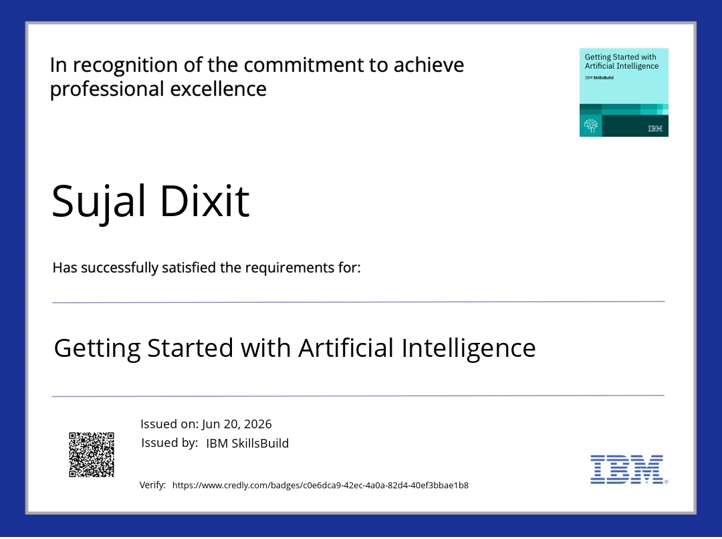
Certificates Earned:
Please add your credly certificate

Slide 18
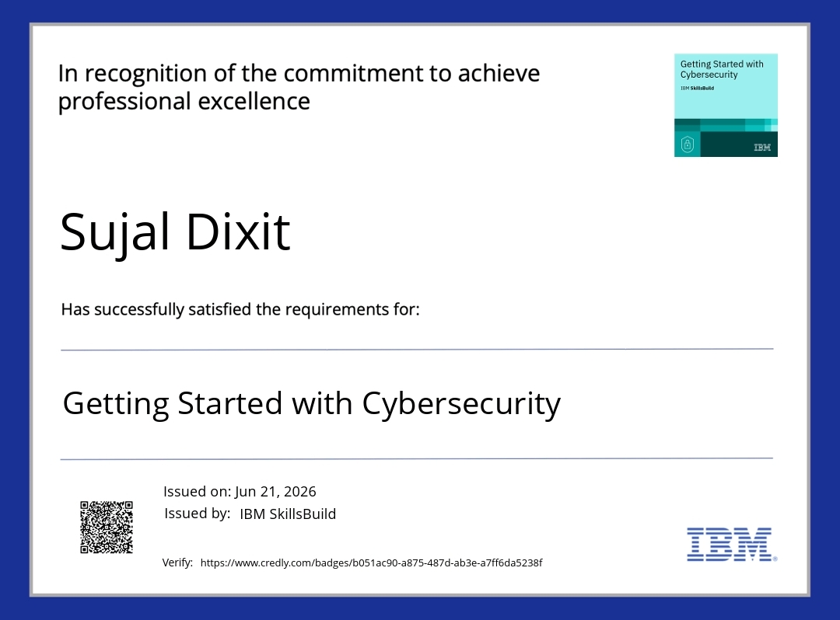
Certificates Earned:
Please add your credly certificate

Slide 19
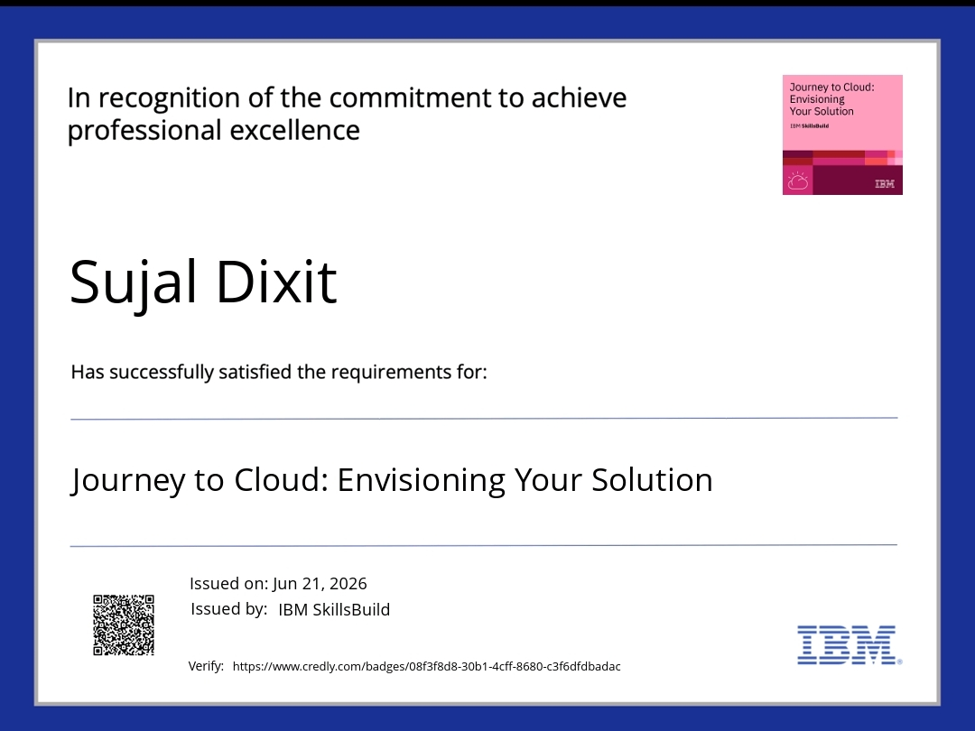
Certificates Earned:
Please add your credly certificate

Slide 20
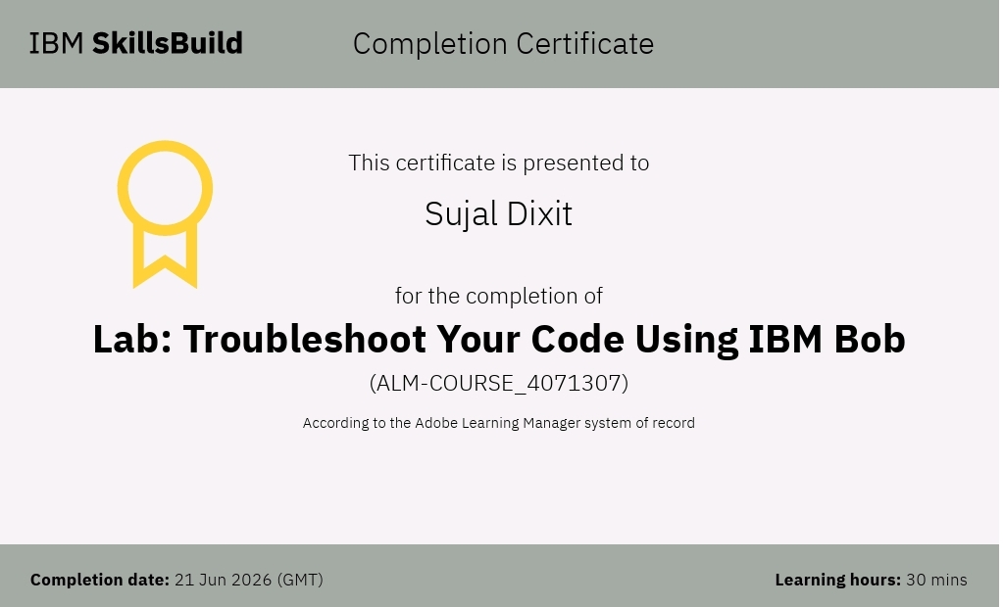
Certificates Earned:​
Add your IBM BOB Certificate

Slide 21


